Slide 1
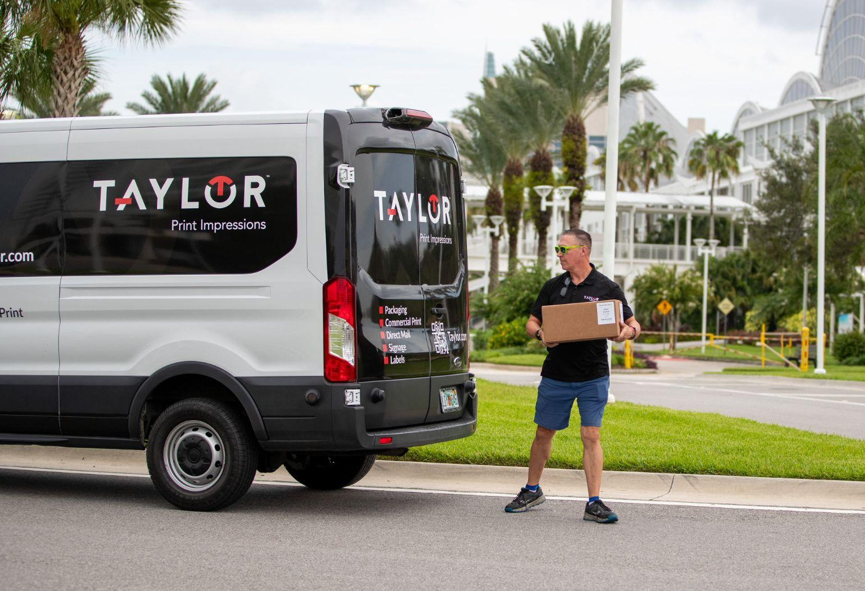
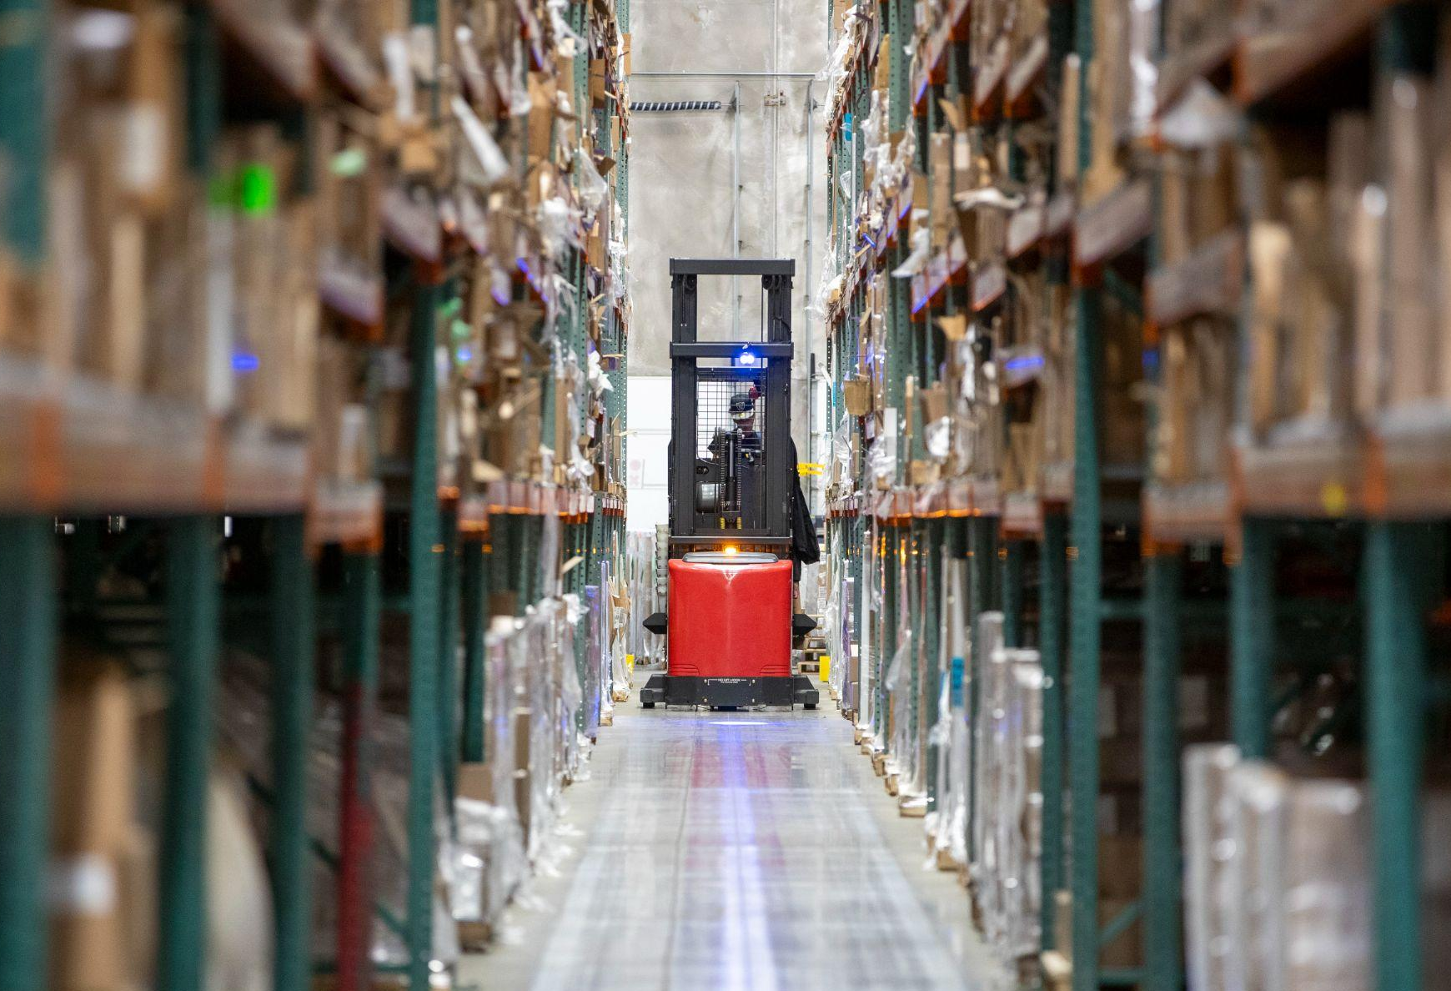
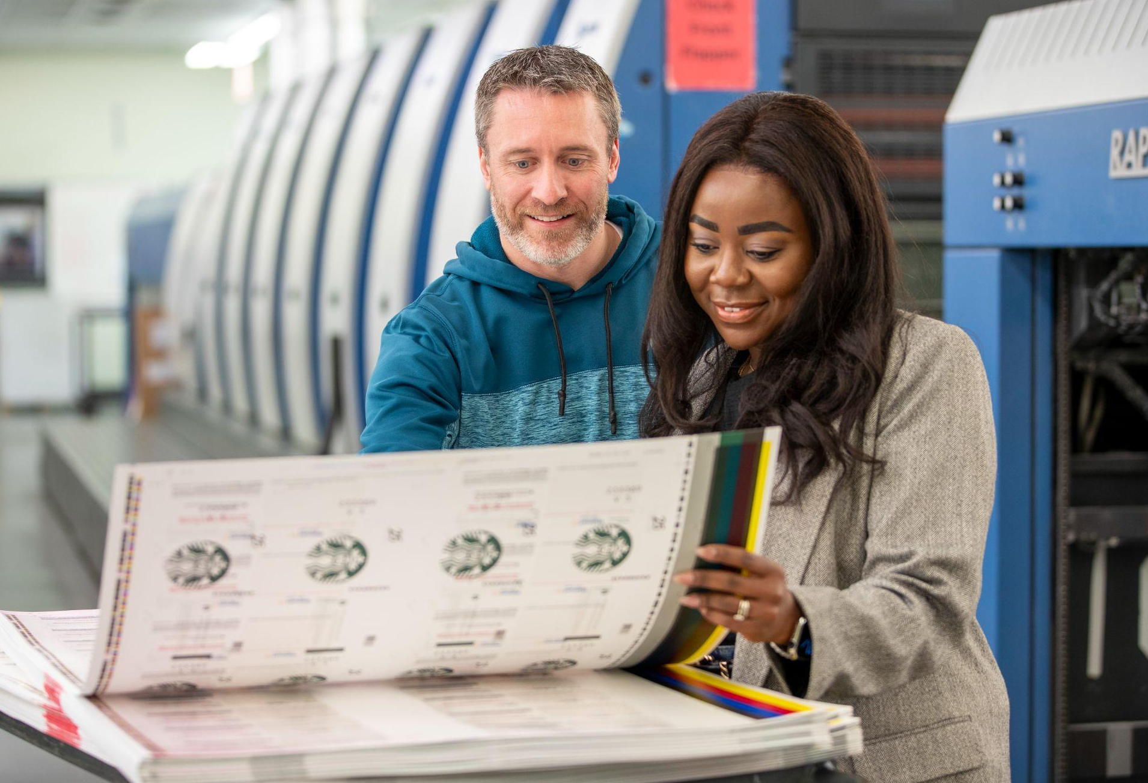
Temporary Employee

Slide 2
Lunch/Break Times
8-hour Shifts
Hourly employees scheduled for an 8-hour shift are provided a 30-minute paid meal period. Employees are required to clock OUT and IN from the timekeeping system.
Lunch break times will be communicated by your Manager.
Break times are 15 minutes and is considered “paid time”, you do not clock out/in for Break.
Missed Punch Form:
  If you forget to punch in or out, notify your supervisor immediately and request a Missed Punch Form to correct your hours recorded.
  Failure to submit a Missed Punch Form may result in missed time on your paycheck.

Slide 3
Unlawful Harassment
It is our policy to maintain a working environment free from discrimination, offensive behavior or harassment based:
Race
Color
Ethnicity
Creed
Religion
Sex
Sexual orientation
Gender identity
Marital status
Union membership
Age
National origin
Disability
Political affiliation
Other legally protected class.

Slide 4
Unlawful Harassment
Forms of harassment:
Any unwelcomed behavior that makes someone feel uncomfortable, including:
Verbal
Physical
Mental
Sexual
Nonverbal (written or gestures)
Sexual harassment – unwanted sexual advances, requests for sexual favors, and other verbal or physical conduct of a sexual nature.
Other forms of unlawful harassment include slurs, stereotyping or hostile acts.

Slide 5
Unlawful Harassment
How to report harassment?
Supervisor
Human Resources
While unlawful harassment is prohibited, we will not tolerate retaliation against anyone who, in good faith, reports any violation of this policy or assists in an investigation.

Slide 6
Personal Electronic Device Policy
Cell phones:
                The use of cell phones and cell phone cameras is strictly prohibited at all times on the production floor.
                Employees may keep their cell phones with them during work hours; however, usage should be limited to emergency or work-related calls only. Activities such as texting, listening to music, personal phone calls, web browsing, social media, streaming videos, (e.g., YouTube) and similar non-work-related use are only permitted during approved breaks and lunch periods.
o

Slide 7
Smoking Policy
Smoking or vaping is only allowed in your personal vehicle or designated smoking area and on your scheduled break times.
If company property is not properly maintained (example: cigarette butts or other smoking-related wastes are found on the property grounds), smoking and the use of tobacco products on the premises may be eliminated completely, at the discretion of Company management.
The use of any tobacco products on company grounds outside of this designated areas is strictly prohibited.

Slide 8



Safety
taylor.com
CONFIDENTIALITY NOTICE: This document contains confidential information intended solely for the recipient(s) named herein.
The information set forth in this document may not be reproduced or disclosed by the recipients(s) without the prior written consent of the author.
14

Slide 9
Safety
Hair/ Jewelry/Loose Clothing Policy
While working sweatshirt hoods need to be down, hood cords - hair- head scarves - jewelry and loose clothing must be tied back or tucked in so that they do not hang down more than 3” when leaning over in any direction.
Shoes
No open toe or heel shoes are allowed.

Slide 10
Safety
Think Safe…
Work Safe… Go Home Safe!

